Slide 1
Research in Biomedicine and Health – I
Department for Research in Biomedicine and Health

Slide 2
2007:
Directive 2005/36/EC on the recognition of professional qualifications
Article 24: Basic medical training

Slide 3
3. Basic medical training shall provide an assurance that the person in question has acquired the following knowledge and skills:
(a) adequate knowledge of the sciences on which medicine is based and a good understanding of the scientific methods including the principles of measuring biological functions, the evaluation of scientifically established facts and the analysis of data;
(b) sufficient understanding of the structure, functions and behaviour of healthy and sick persons, as well as relations between the state of health and physical and social surroundings of the human being;
(c) adequate knowledge of clinical disciplines and practices, providing him with a coherent picture of mental and physical diseases, of medicine from the points of view of prophylaxis, diagnosis and therapy and of human reproduction;
(d) suitable clinical experience in hospitals under appropriate supervision.

Slide 4
Vertically and horizontally integrated course
Year 1: 50 h – Knowledge and skills in research methodology, medical informatics and statistics
Year 2: 25 h – Practical application of research methodology
Year 3: 25 h – Evidence-based medicine

Slide 5
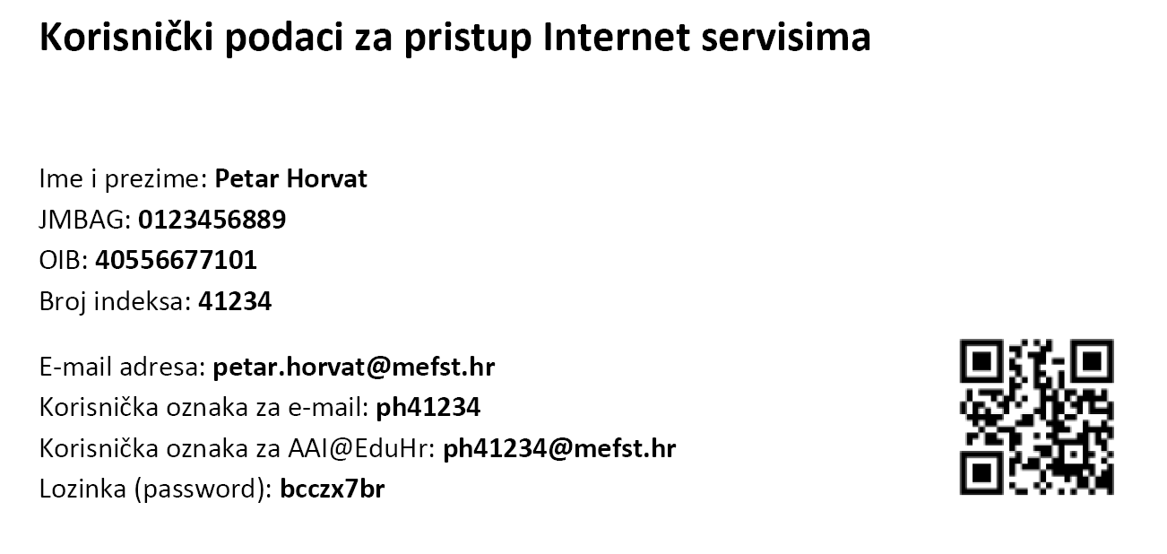
Course:
Exam: 10 practicals (each 1 point) + 4 quizzes (each 5 questions – 20 points) + written test of 20 questions (20 points) – final mark

Slide 6
Characteristics of scientific work in medicine
asking important questions, identifying key problems, clear formulation of questions
collecting and assessing relevant information, effective understanding of information
making correct conclusions and solutions, and testing them according to relevant criteria and standards
approaching problems with an open mind
effective communication with others in reaching solutions to problems

Slide 7
Characteristics of clinical work in medicine
asking important questions, identifying key problems, clear formulation of questions
collecting and assessing relevant information, effective understanding of information
making correct conclusions and solutions, and testing them according to relevant criteria and standards
approaching problems with an open mind
effective communication with others in reaching solutions to problems

Slide 8
(1) Science is (2) striving of (3) humankind for (4) genuine (5) knowledge
(1) Science
Description of Nature
Testability of findings
Tentative conclusions
Reality of the world
Measuring (counting, weighting)
Experiment
(2) Striving
Truth
Hypothesis
Theory
Paradigm
(Popper/Kuhn)
(3) Humankind
Communication
Consensus
Publishing (information transfer)
English
(5) Knowledge
Innovation chain
Education
Culture
Moral
Discoveries
Patriotism
(4) Genuine [knowledge]
Rationality
Data
Statistics
Control group
Evidence/argument
Ethics
Levels of irrationality:
1. loses argument with own other arguments
2. contradictory to known common knowledge
3. knows has not searched enough, but thinks this sufficient
4. thinks has searched all, but has not
5. has searched all, but the existing knowledge is not sufficient

